Slide 1
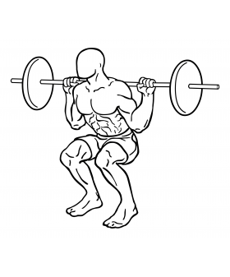
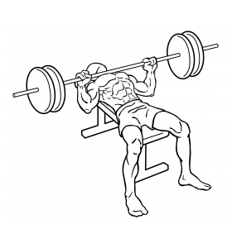
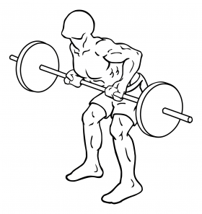
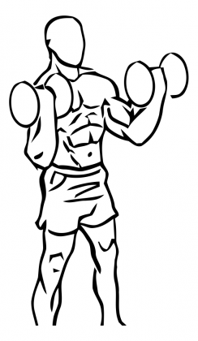
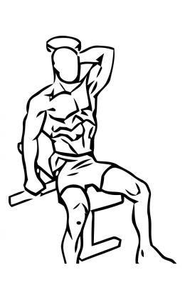
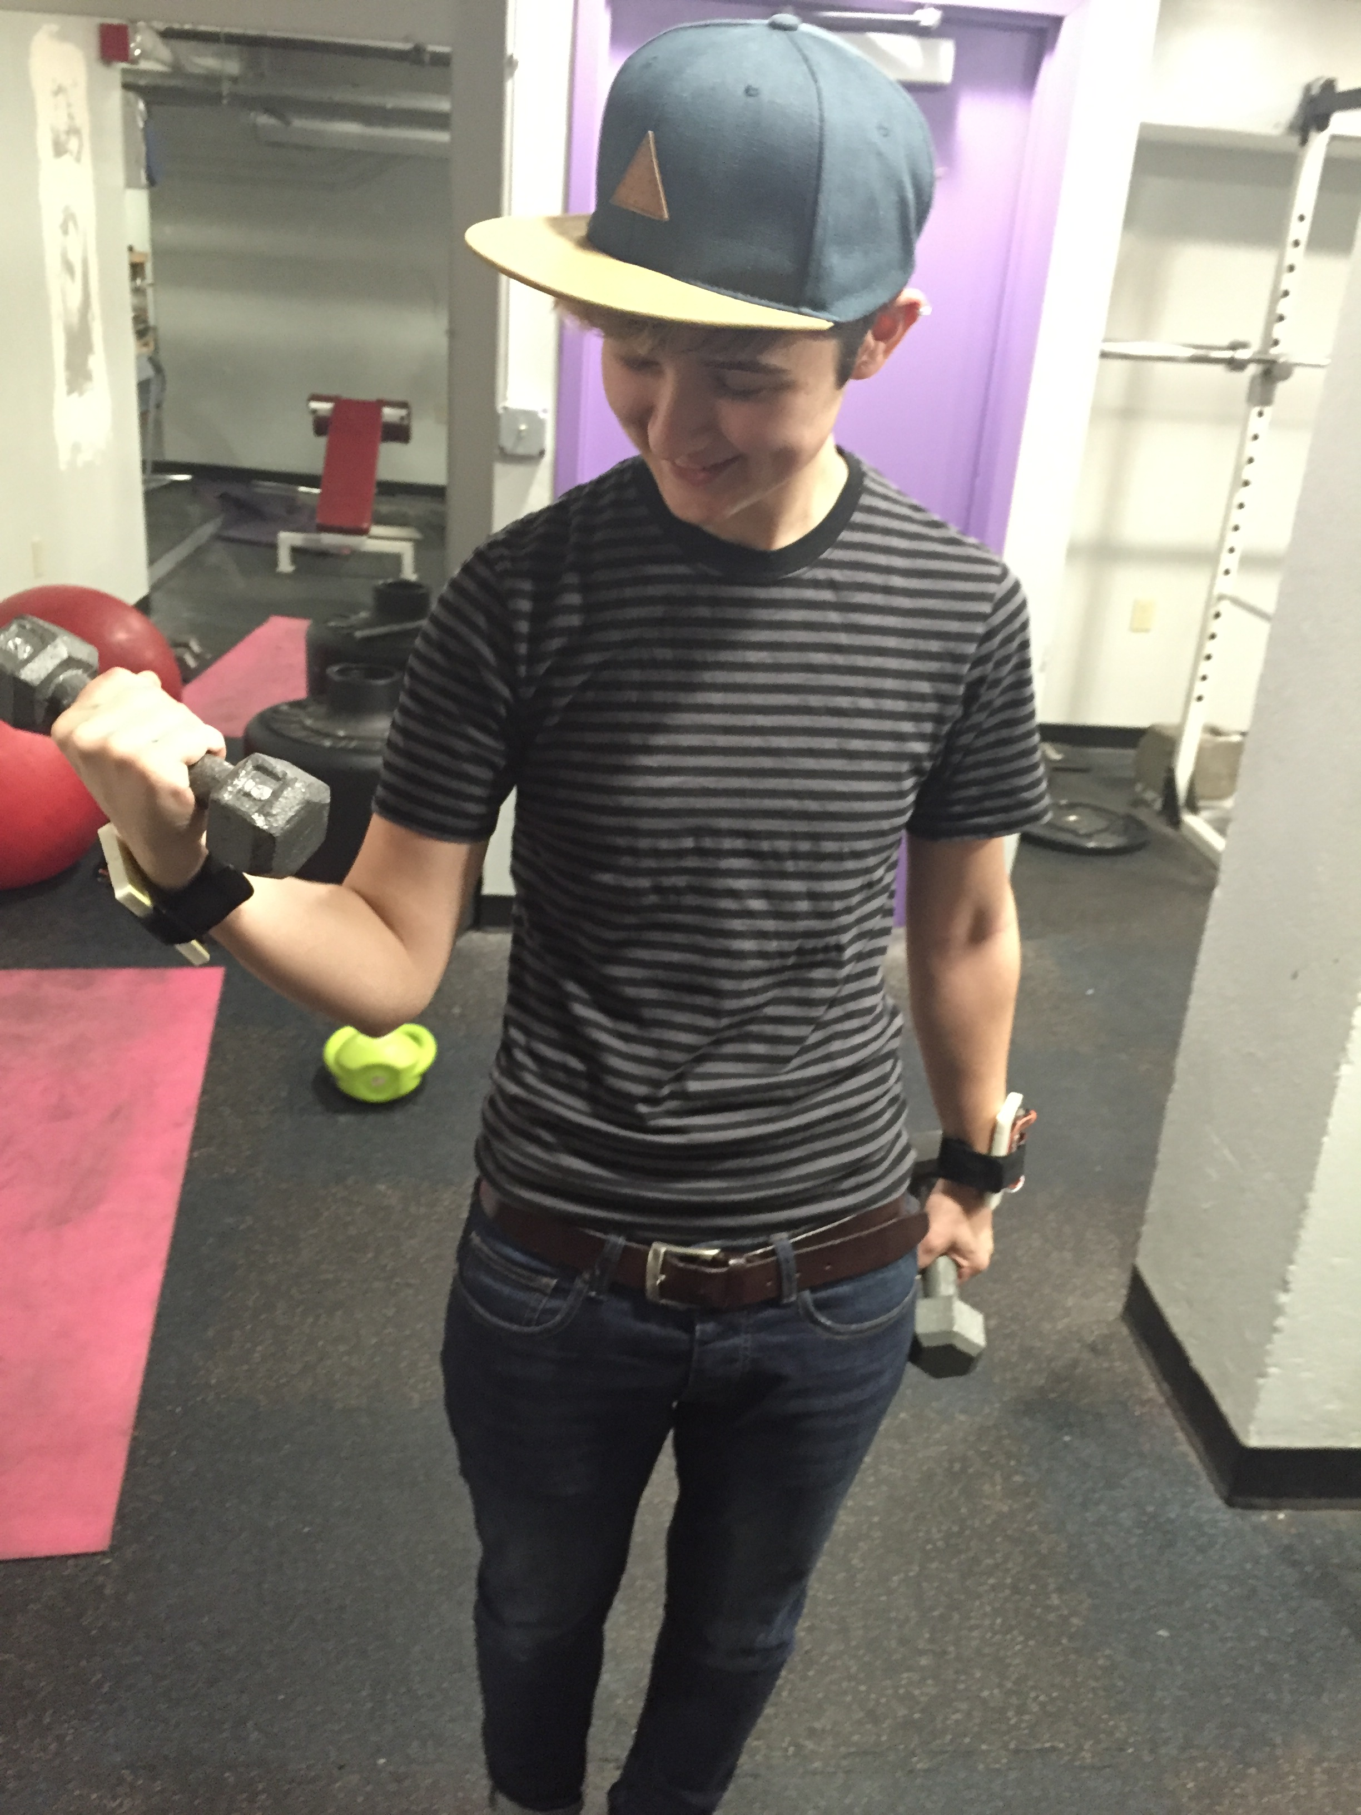
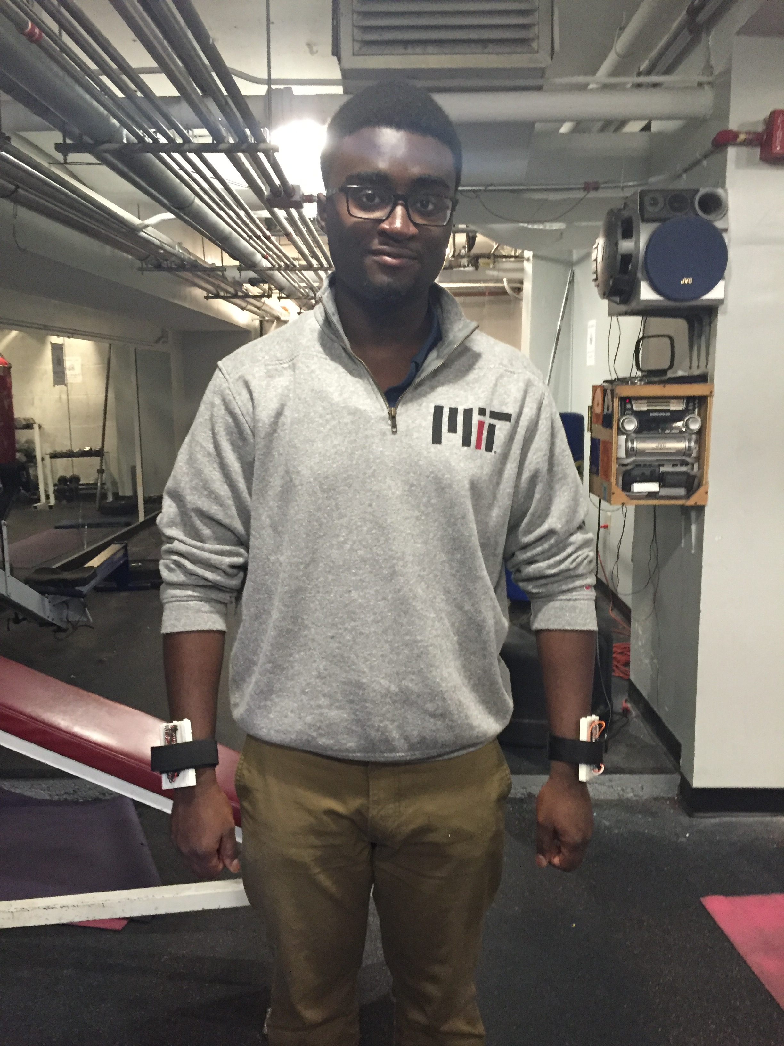
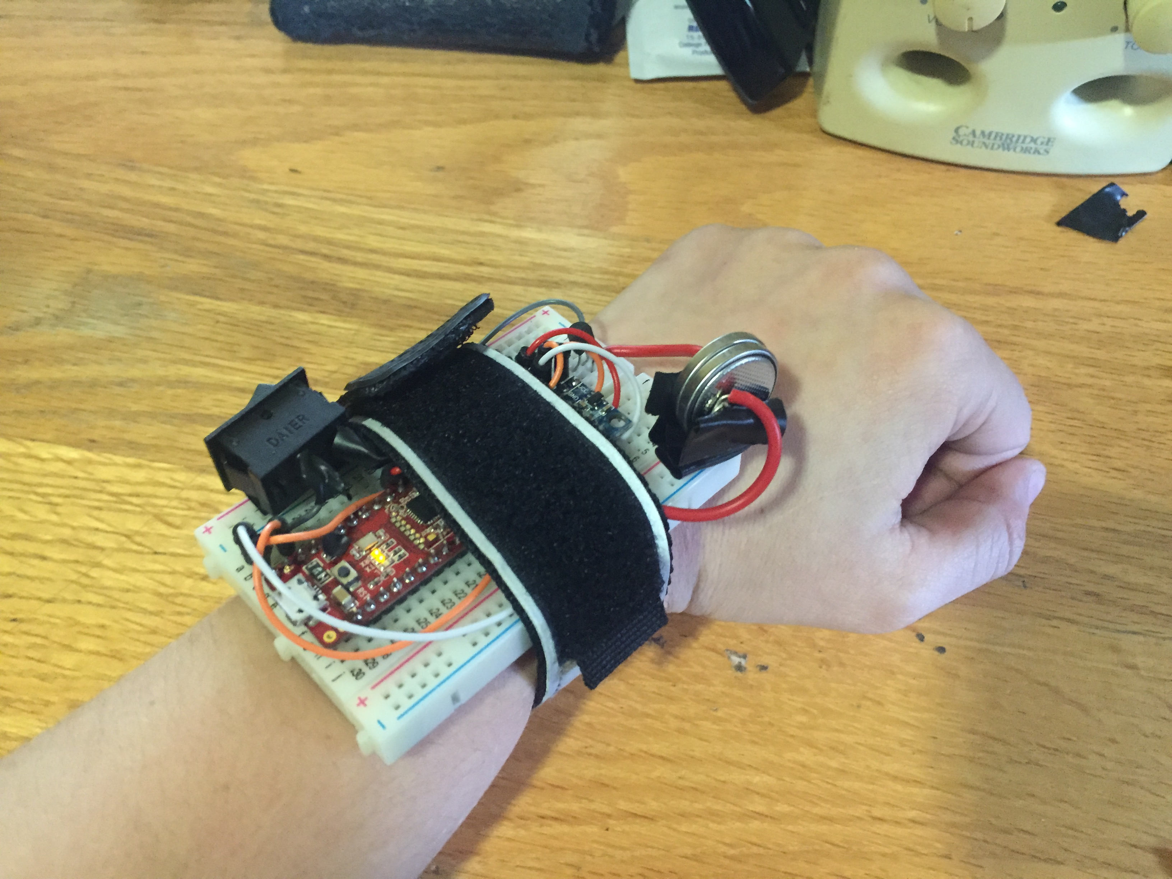
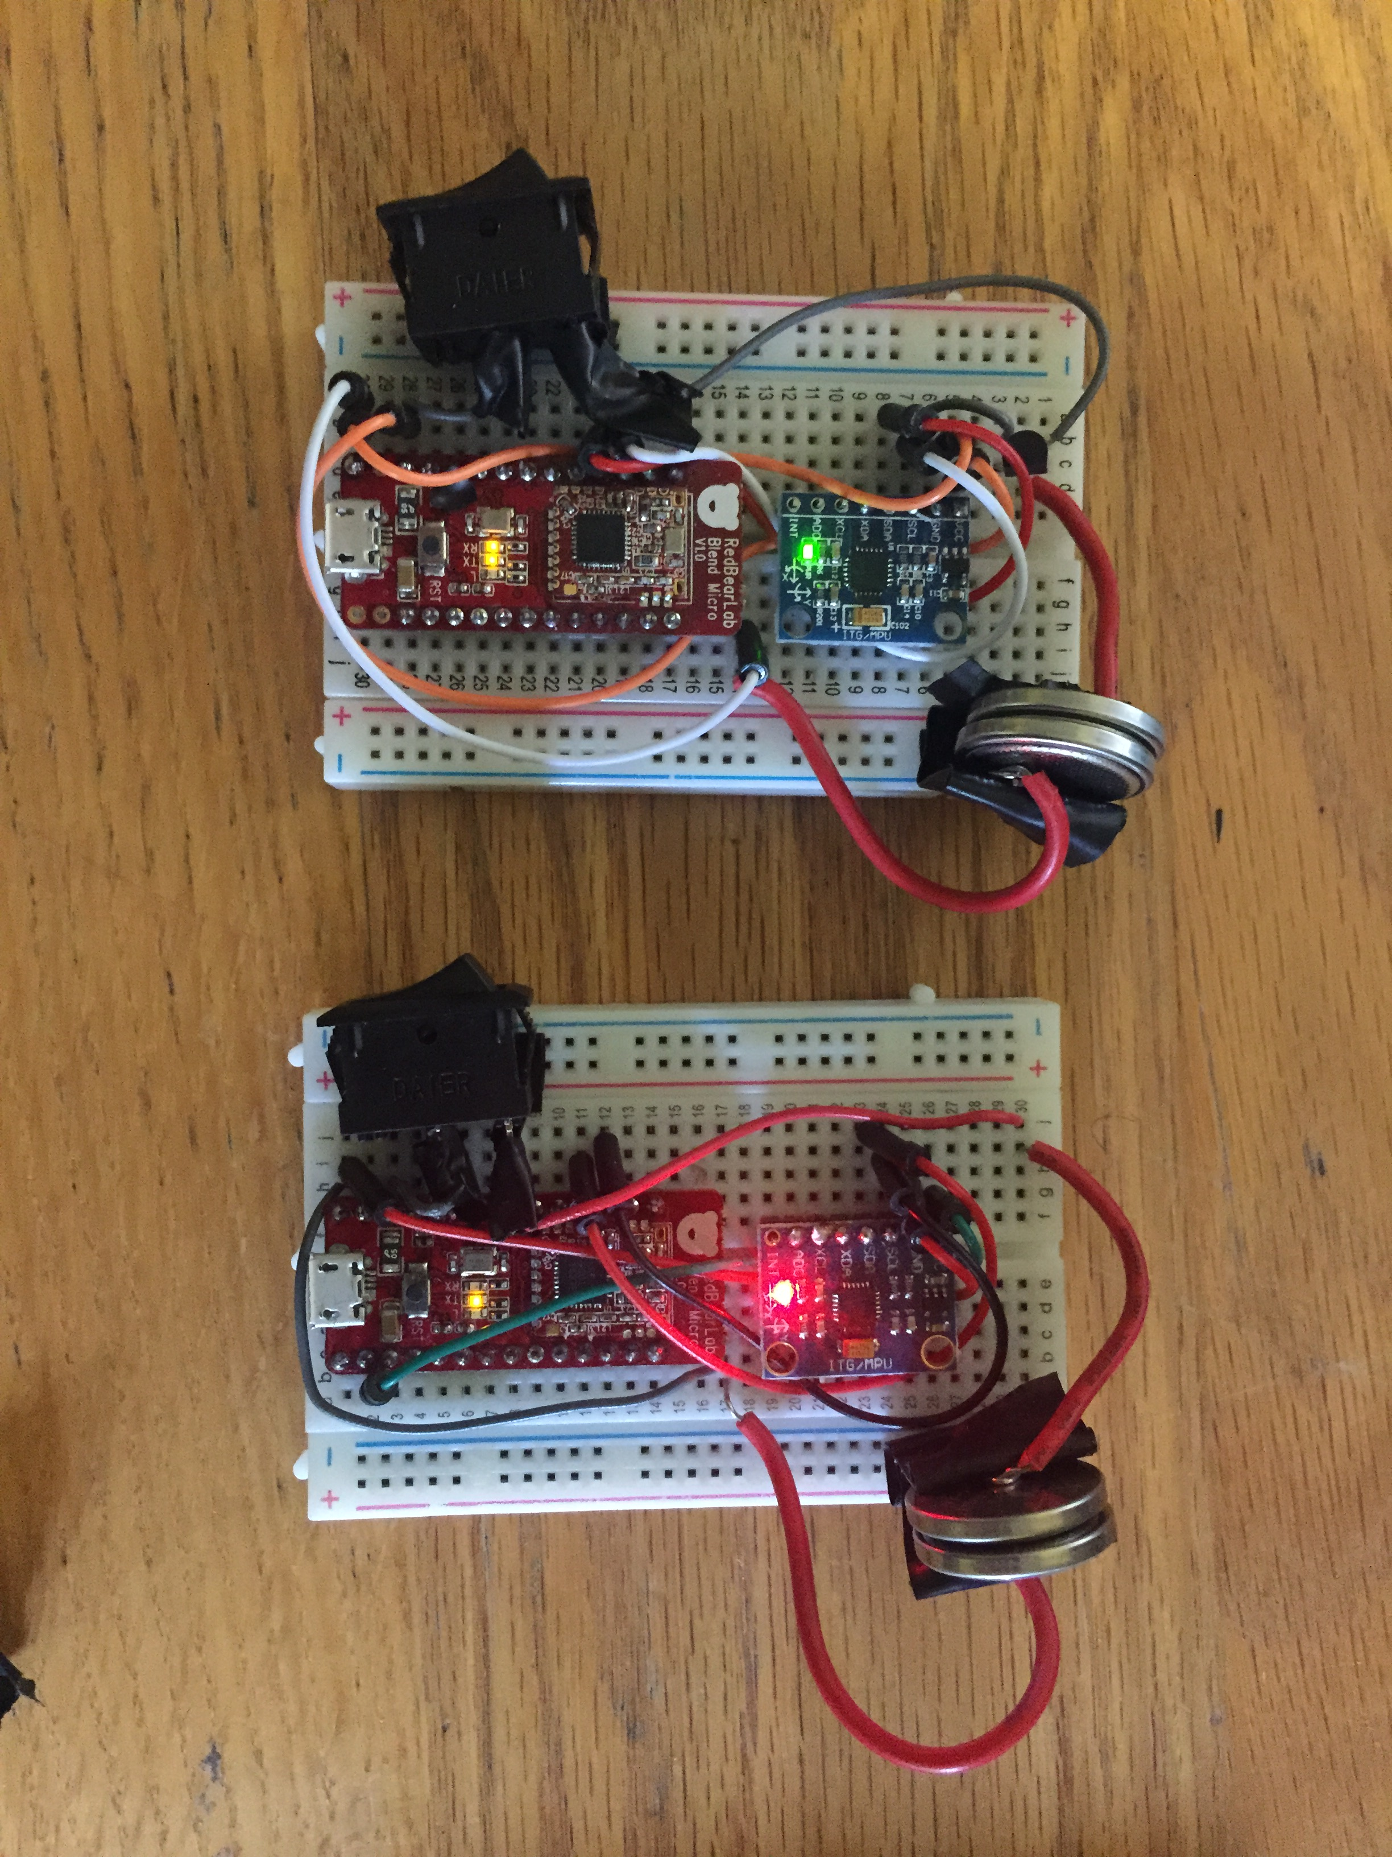
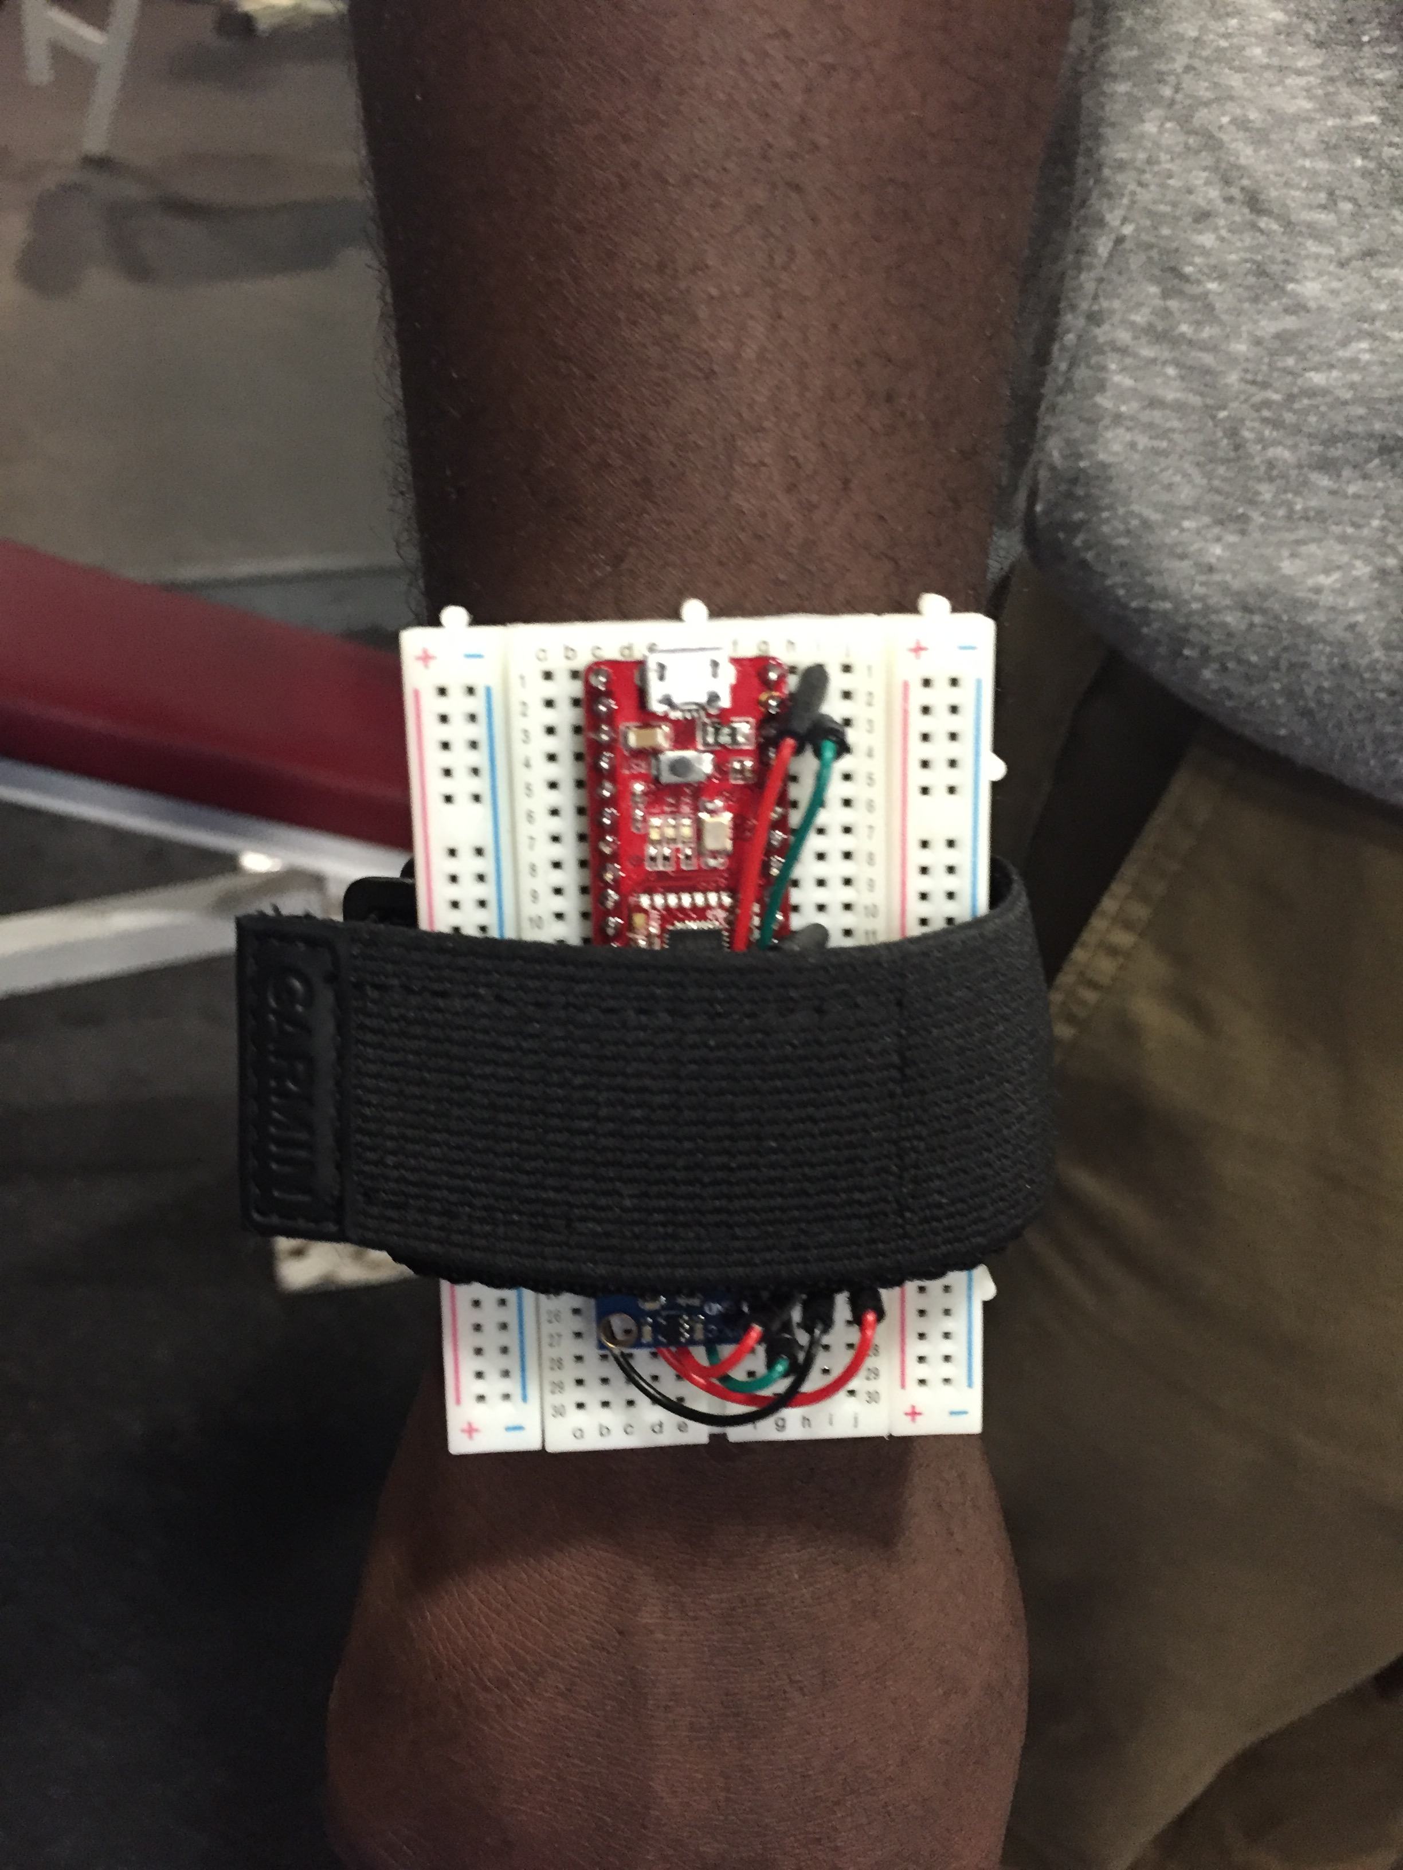
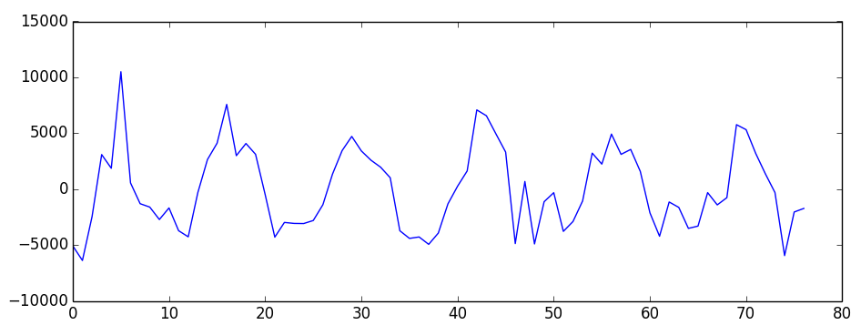
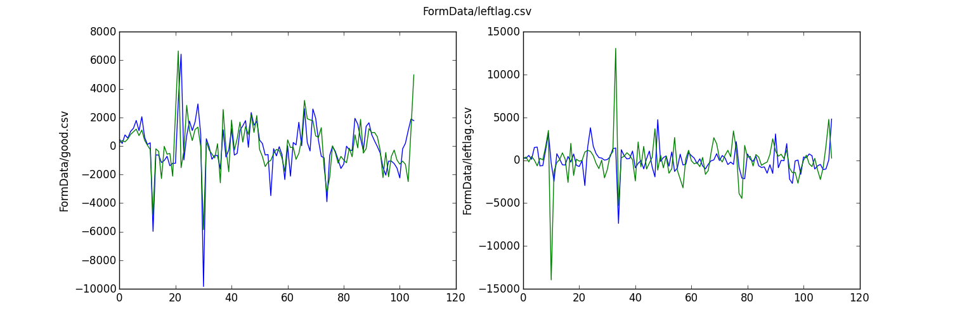
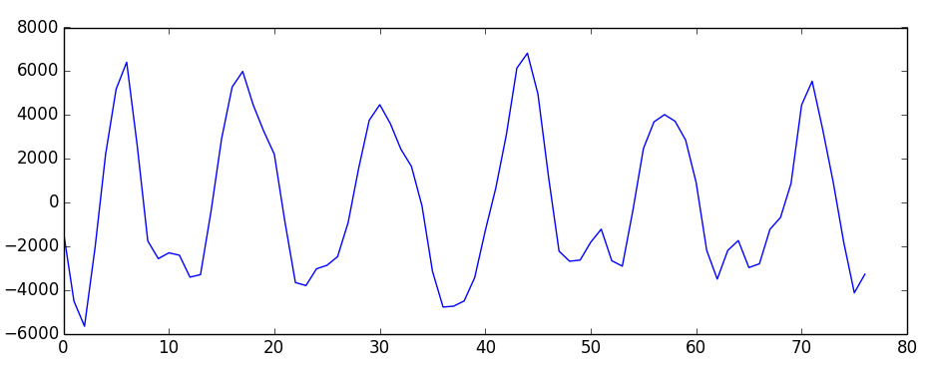
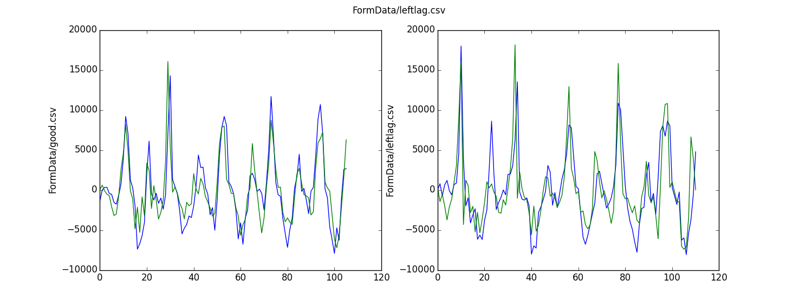
Activity Recognition for Weight Lifting
Katie Bartel
Kwame Efah
a b c d e
Determines what exercise is being performed with F1 Score 0.99, Accuracy 0.95
Counts repetitions correctly 92% of the time
Data Collection
Hardware
iOS Software
Collected data from 11 individuals.
Each subject performed the same lifting regiment: 3 sets of 5 repetitions of each exercise: squats (a), bench press (b), rows (c), bicep curls (d), tricep extensions (e)
Each wearable sensor module consists of a MPU6050 and a RedBearLab Blend Micro (with bluetooth). Powered by two 3 volt coin cell batteries. Collects data at 10 Hz. Data includes 3 axes of accelerometer and gyroscope.
We created an iOS app which performs the classification and repetition counting algorithms on the collected data.
Activity Recognition
AccelY <= -0.5g
True
False
Rep Counting
Bent Over Rows
AccelZ <= -0.25g
Form Correction: Bench Press
Bicep Curls
AccelZ <= 0.30g
AccelX <= 0.46g
Squats
Bench Press
Tricep Extensions
Accelerometer Y: Cross correlation on average 10 times higher in good form
Trained CLF Tree uses mean values of accelerometer X, Y, Z axes to recognize activity
Low pass filter removes noise; then count zero crossings
Fc = 3.5 Hz, Q = 0.7, Gain = 6 dB (chosen experimentally)
Gyroscope Z: Larger spikes in poor form

